Slide 1
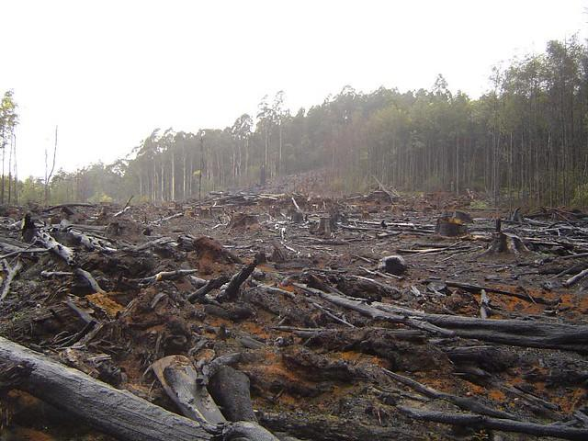
Human Impacts on Food Webs
We will predict the effect of human activity on local habitats using food webs.
Notes:
Insert cover image and use transparency settings to fade image.

Slide 2
Do not delete this slide.
This slide is designed so that you can copy the prompt box you need and insert it into your slides.
This slide is hidden and will not be included when presenting your lesson.
TRACK WITH ME
CHECK FOR UNDERSTANDING
VOCABULARY
1 -
HINT
Students, remember….
READ WITH ME
TEACHER CUE
MAKE THE CONNECTION
Students, you already know….
EXTENSION

Slide 3
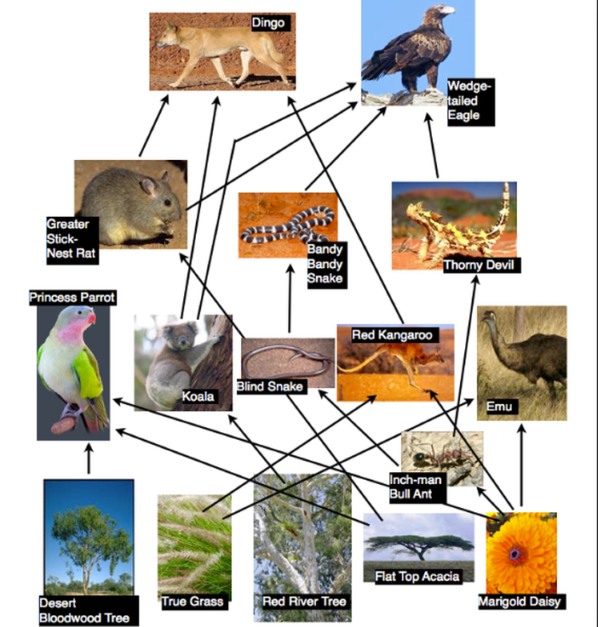
1.Identify two producers.
2. Identify one primary consumer.
3. Identify one tertiary consumer.

Slide 4
Repeat the opposite word/phrase.
HABITAT
WHERE AN ORGANISM LIVES

Slide 5
Repeat the opposite word/phrase.
FOOD CHAIN
SHOWS TRANSFER OF ENERGY BETWEEN ORGANISMS

Slide 6
Repeat the opposite word/phrase.
FOOD WEB
SHOWS TRANSFER OF ENERGY WITHIN ECOSYSTEMS

Slide 7
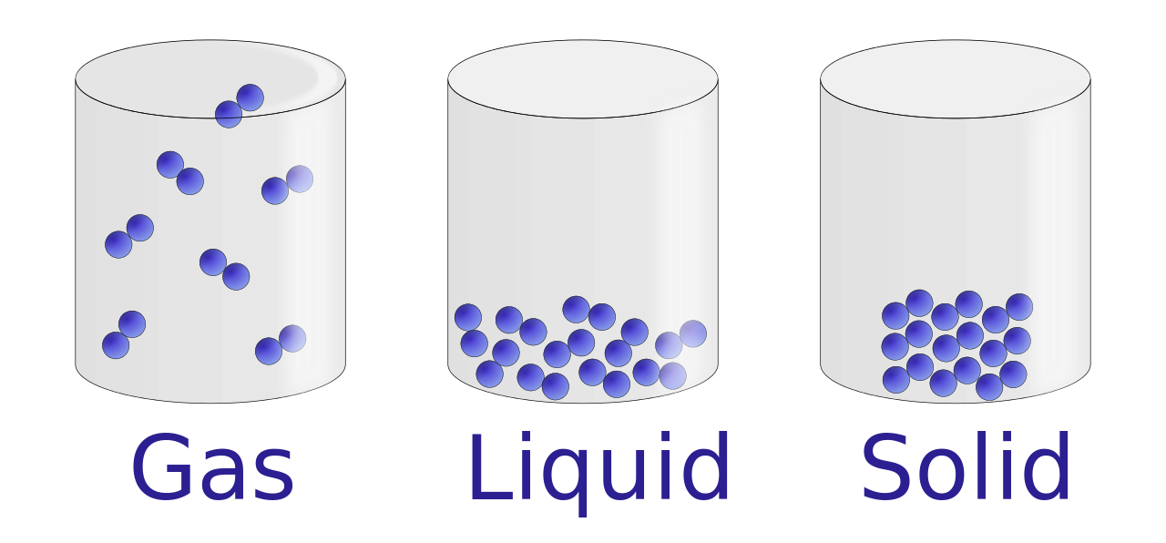
True or False?
Solids have a fixed shape.
Gas particles are close to each other.
Solid particles move in one spot.
Gas particles can expand or contract to fill their container.
Liquids take on the shape of their container.

Slide 8
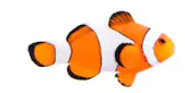
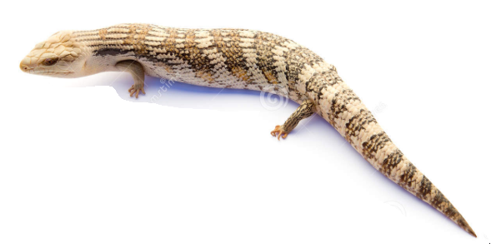
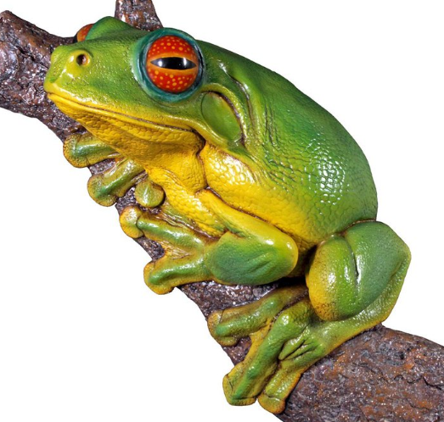
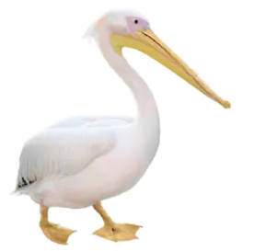
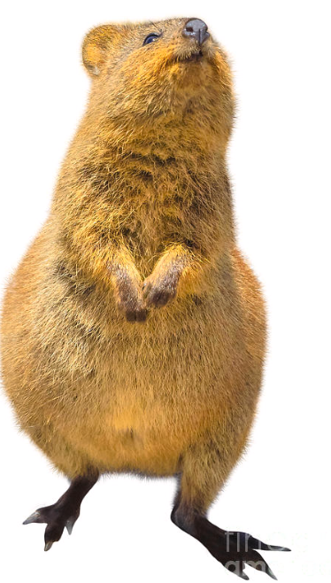
Match the observable features to the vertebrates below.
A: Clown Fish
D: Blue Tongue Lizard
Observable features
Feathers & beak
Hair/fur
Dry scales
Wet skin
Wet scales
B: Green Tree Frog
E: Pelican
C: Quokka

Slide 9
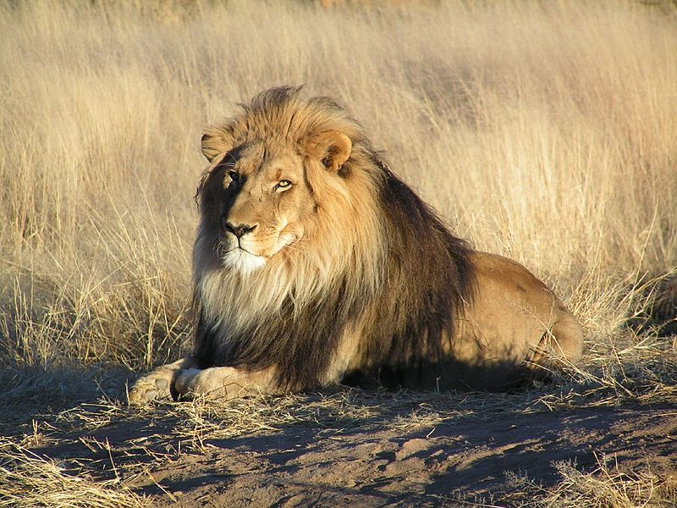
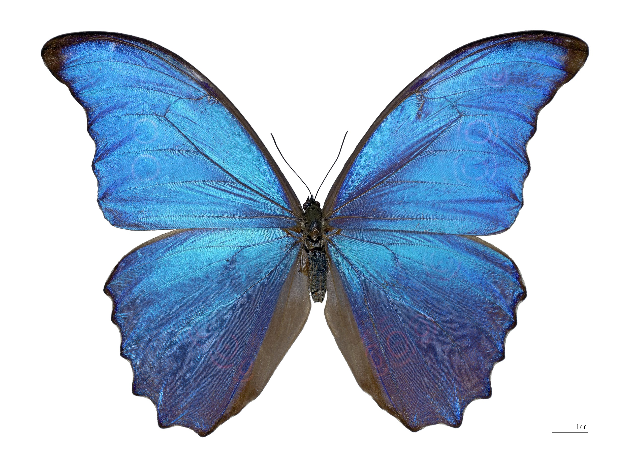
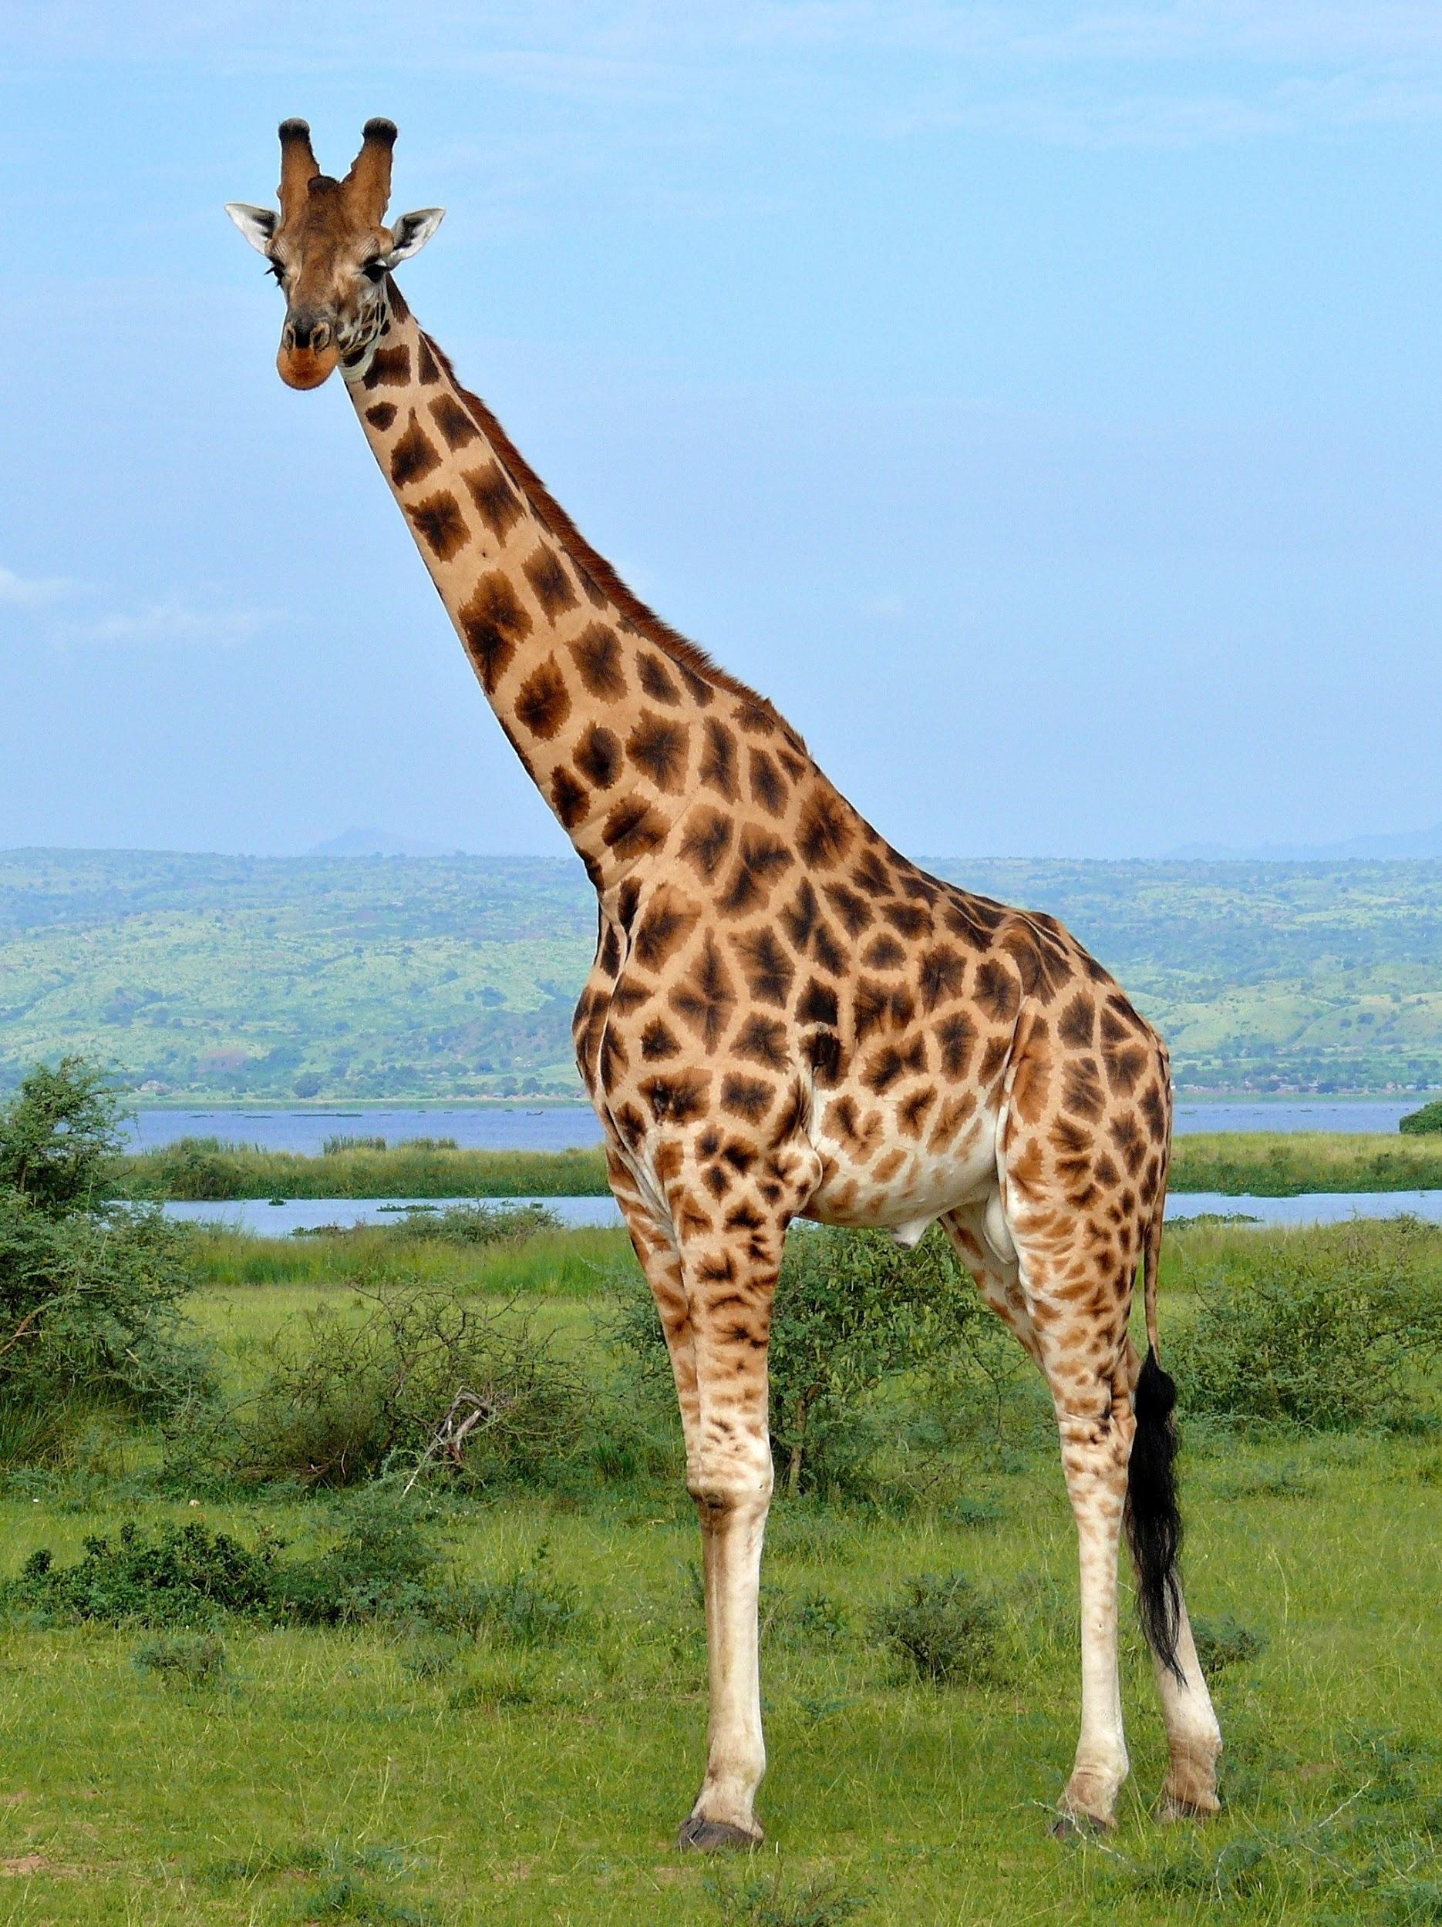
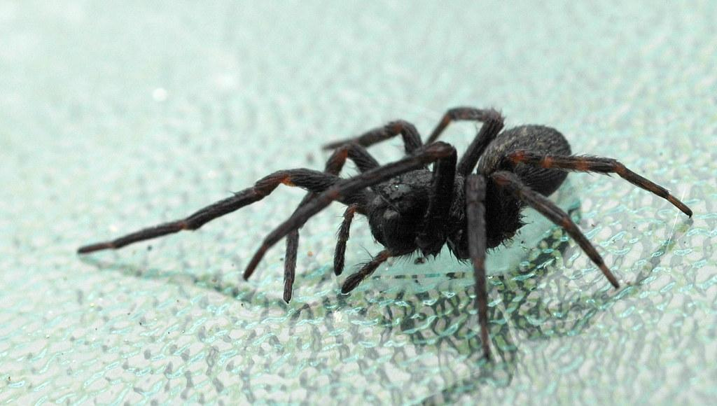
Construct a dichotomous or tabular key using the following four animals using their observable features.

Slide 10
We will predict the effect of human activity on local habitats using food webs.
TRACK WITH ME
READ WITH ME
We will define deforestation and agriculture.
We will use examples of human activity affecting local habitats.
DECLARE THE OBJECTIVE
Read the learning objective to your partner.
Notes:
Learning Objectives contain concepts (nouns, big ideas), skills (verbs, measurable behaviours) and sometimes context (restricting or targeting conditions).
●Example: Students will be able to describe the concept of density and apply it to floating and sinking.
●
Success criteria are specific measurable outcomes that if met mean that the student has met the learning objective.
Examples:
•Students will be able to compare densities of substances using mass and volume.
•Students will be able to identify whether a solid or liquid will float or sink in a liquid based on their densities.

Slide 11


Slide 12
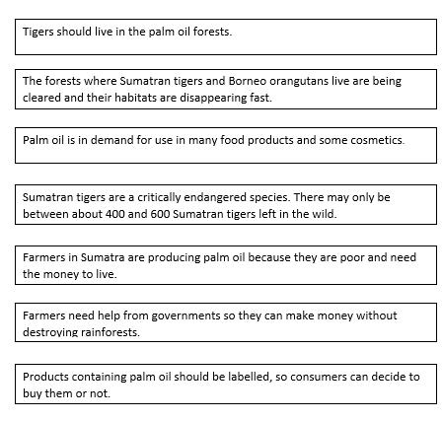
Arrange the boxes with the issues you highlighted on this page in order, from most
Important issue to least.

Slide 13

We will predict the effect of human activity on local habitats using food webs
https://www.pbslearningmedia.org/dbdcadd0-3996-4cea-b74b-f52d3459f28a
Answer the following questions in your workbook.
1. After watching the video on introduced species and biodiversity, your friend is confused about exotic, introduced, and invasive species and asks you to explain how they are the same or different. In your own words, write a few sentences to explain the meaning of these terms:
exotic species
introduced species
invasive species
2. Your friend tells you that a good way to increase biodiversity is by intentionally introducing a species to a new environment because the introduced species increases the species richness of that area by one species. Do you agree or disagree with your friend’s statement? Hint: Use the example of the comb jellies that were introduced to the Black Sea to explain how introduced species can cause a decrease in species richness in an area.
3. In a few sentences, explain the relationship between human population growth and threats to biodiversity.
Notes:
Please include tasks/questions here rather than just referring to a worksheet. This will save on photocopying and facilitate sharing with other schools.
Try and build tasks/questions which escalate through Bloom’s Taxonomy. This will help with differentiation.

Slide 14
We will predict the effect of human activity on local habitats using food webs
A food chain shows how energy is transferred from one living organism to another via food.
A food web shows how energy is transferred between organisms in an ecosystem via food.
There are factors that affect how much food is available to organisms.
What factors affect how much food is available to organisms?
MAKE THE CONNECTION
Students, you already know that a new population or an introduced species can affect a food web.

Slide 15
We will predict the effect of human activity on local habitats using food webs
Australia is covered in many different types of landscapes and a variety of vegetation that supported many species of organisms.
Today, humans are clearing land at the massive rate of over half a million hectares a year, for the purpose of building homes, agricultural land or industrial land. This clearing of land is known as deforestation.
CHECK FOR UNDERSTANDING
What is deforestation and why do humans do it?

Slide 16
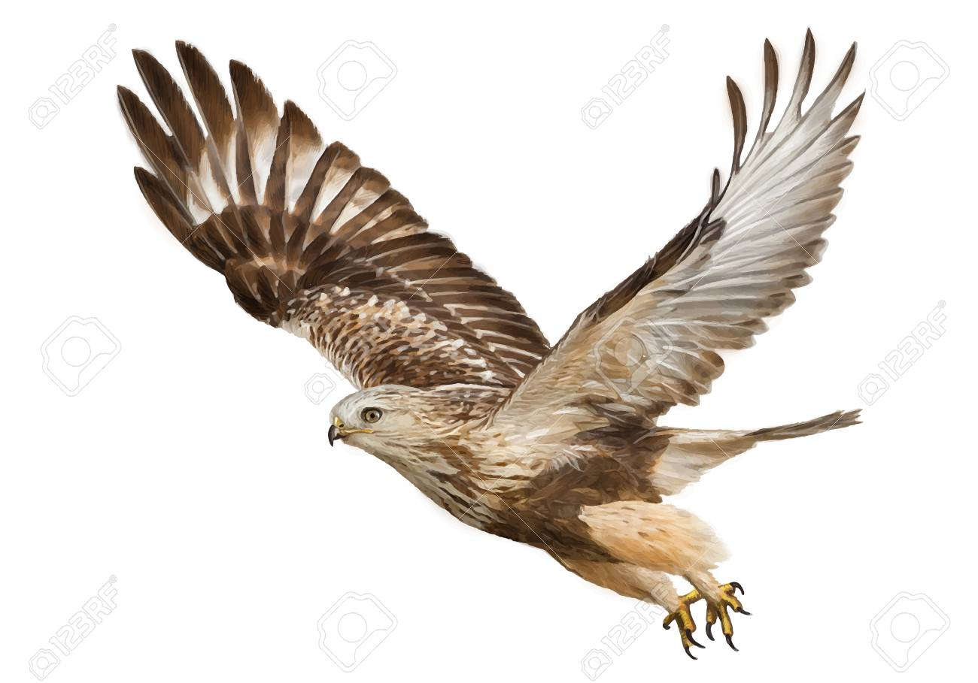
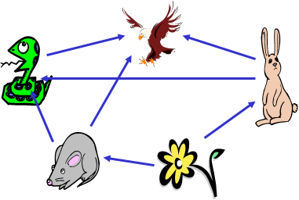
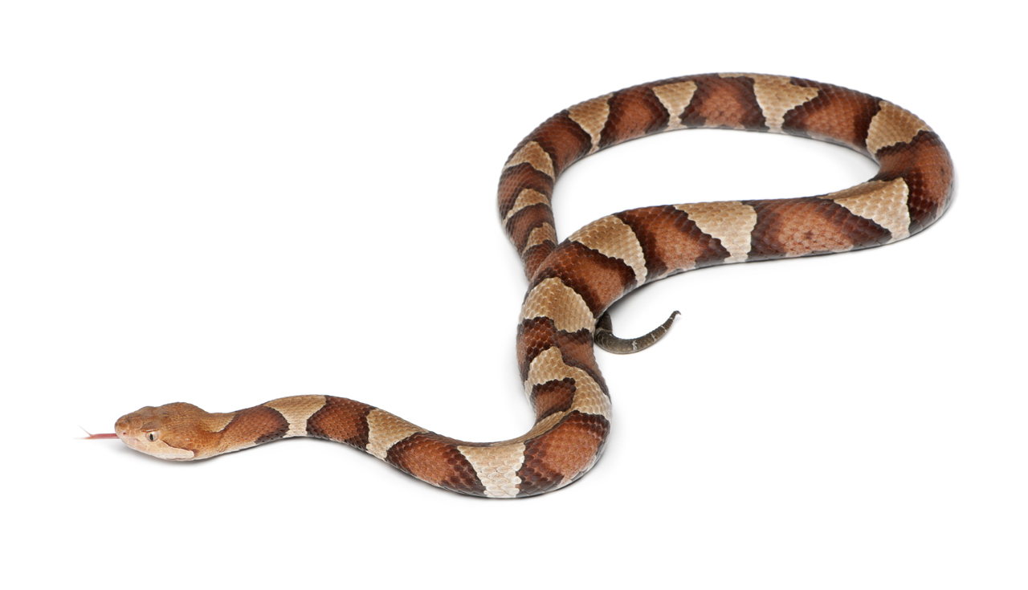
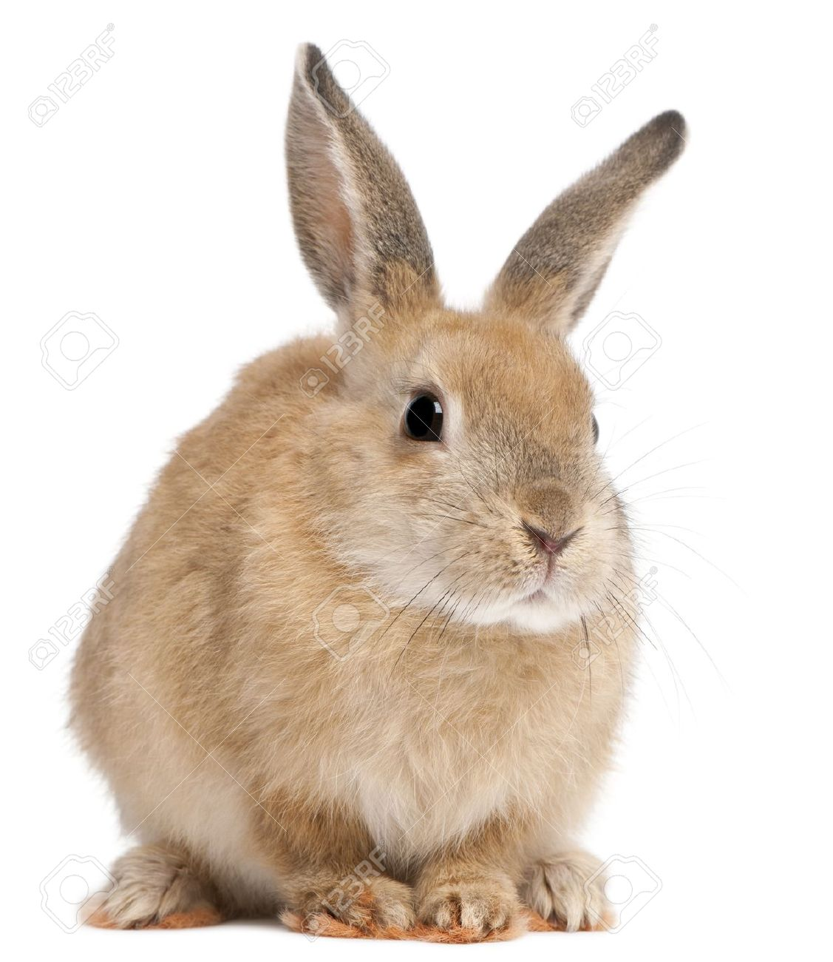
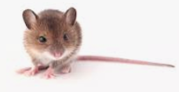
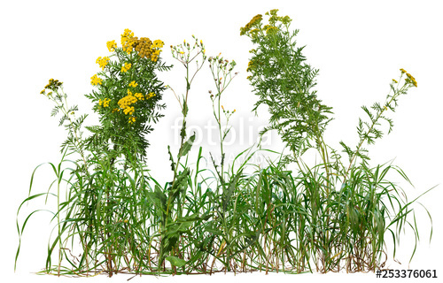
We will predict the effect of human activity on local habitats using food webs
The food webs that existed in these areas have been changed as new predators move in and the number of producers decreases.
The food web to the right was cleared of grass due to deforestation.
CHECK FOR UNDERSTANDING
What impacts would deforestation have on this food web?
VOCABULARY

Slide 17
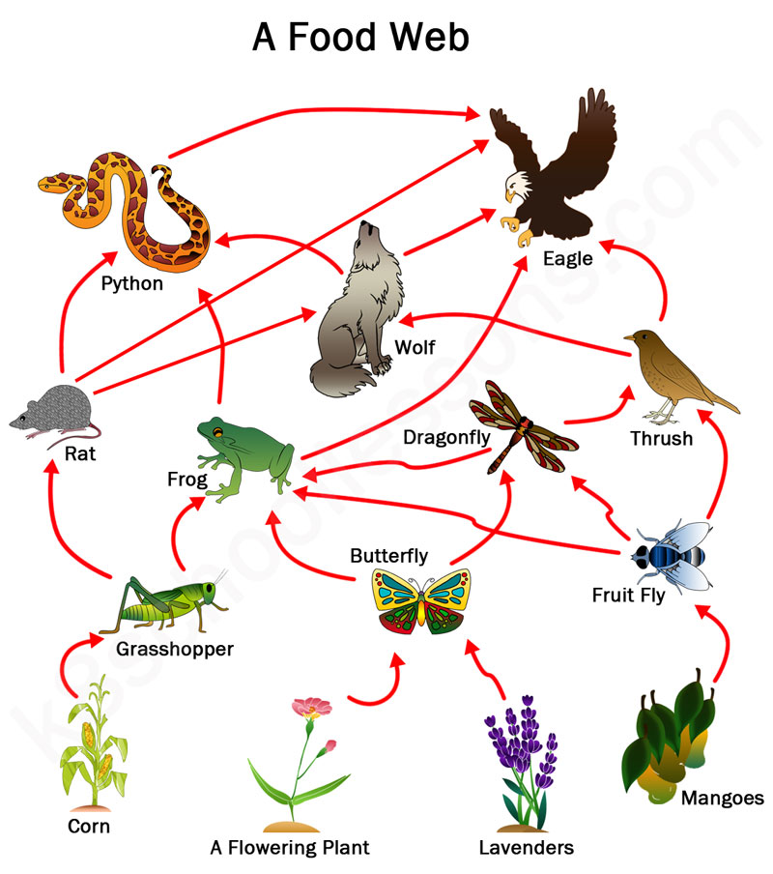
We will predict the effect of human activity on local habitats using food webs
CHECK FOR UNDERSTANDING
How would the food web below be affected if all the flower and lavender plants were cleared?
The main cause of loss of habitat is the clearing of land for agriculture₁.
Herbivores eat a wide variety of vegetation, but when that vegetation is cleared to grow one type of crop not all herbivores adapt and can die.
Many species of plant and animals are almost extinct due to the constant clearing of land and the changing of habitats.
VOCABULARY
1-Farming

Slide 18
We will predict the effect of human activity on local habitats using food webs
Identify two effects on the food web below if the frogs became extinct due to deforestation.
How would the wolf be affected if there was no more dragonflies?
HINT
Students, remember if one producer is lost or affected in a food web, the entire food web will be affected in some way.

Slide 19
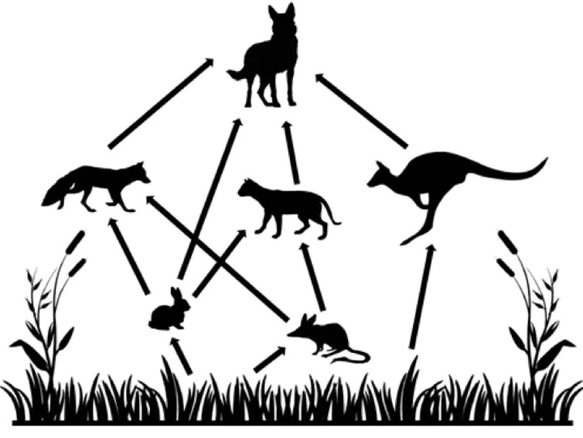
We will predict the effects of introduced species and population changes on local habitats using food webs.
Ecosystems are complex and changes for one organism can impact the whole system.
Food webs allow us to identify the effects of ecosystem change more easily.
CHECK FOR UNDERSTANDING
Would a food chain or a food web be better to see the impacts of change on the whole ecosystem?
Dingo
Fox
Kangaroo
Feral Cat
Rabbit
Bilby

Slide 20
We will predict the effect of human activity on local habitats using food webs
Deforestation is the clearing of land for the purpose of building homes, agricultural land or industrial land.
The primary individual cause of loss of habitat is the clearing of land for agriculture₁.
Deforestation has many effects on food webs, as it reduces producers which limits food sources for consumers.
Many species of plant and animals are almost extinct due to the constant clearing of land and the changing of habitats.
CHECK FOR UNDERSTANDING
Deforestation impacts which part of the food web the most? Primary Consumers Secondary Consumers Producers Apex Predators
VOCABULARY
1- Farming

Slide 21
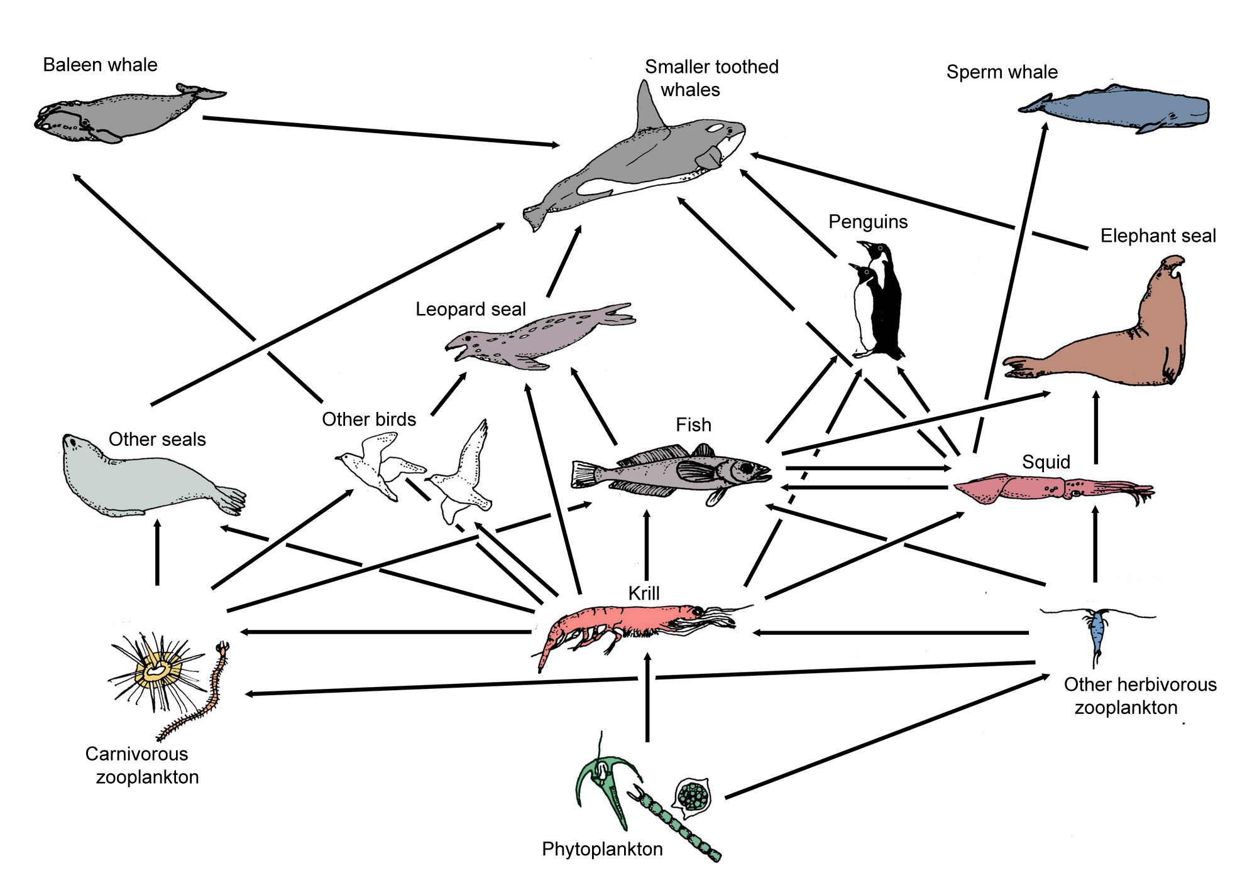
We will predict the effect of human activity on local habitats using food webs
Answer the following questions in your workbook.
What is deforestation?
How is deforestation affecting food webs?
What are three effects on the food web if all the fish were gone due to overfishing?
HINT
Deforestation is the clearing of land for the purpose of building homes, agricultural land or industrial land.. Deforestation has many effects on food webs, as it reduces producers which limits food sources for consumers.
Notes:
Please include tasks/questions here rather than just referring to a worksheet. This will save on photocopying and facilitate sharing with other schools.
Try and build tasks/questions which escalate through Bloom’s Taxonomy. This will help with differentiation.

Slide 22
We will predict the effect of human activity on local habitats using food webs.
We will define deforestation and agriculture.
We will use examples of human activity affecting local habitats.
DEFINITION
CHECK FOR UNDERSTANDING
Check Success Criteria.

